Slide 1
Thinking and Practice: LLM for Cybersecurity
Linzhe Li
Beijing Zhongguancun Laboratory
Powered By NSFOCUS
March 21, 2024

Slide 2

NSFOCUS - Our Technical Partner
NSFOCUS is a leading global internet and cybersecurity company with a strong presence in over 50 offices worldwide.
NSFOCUS protects four large global telecommunications companies and four global financial institutions.
Most of the technical content in this presentation was provided by NSFOCUS.
Notes:
Due to visa issues with Green Alliance staff, they were unable to come to the event. I delivered the presentation as a collaborator instead

Slide 3
Outline
The significance of LLM for cybersecurity
Use case
Summary

Slide 4
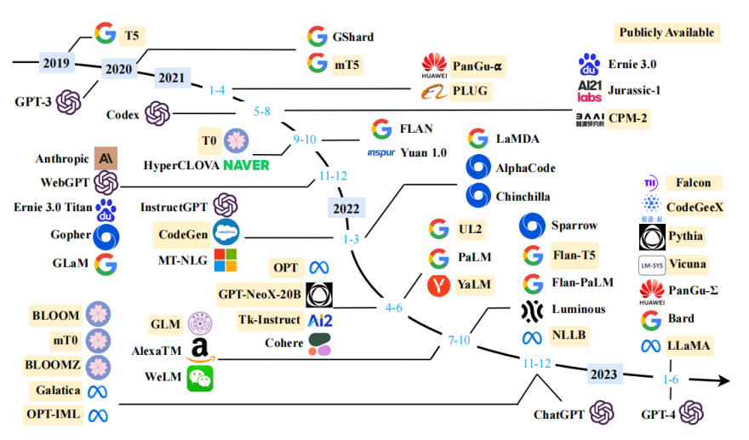
LLM accelerates the transformation of cybersecurity
Related Emergent Ability of LLM
Grasp a wide range of language knowledge and semantic understanding.
Understand and apply logical principles to reason and analyze information in the input text.
Demonstrate a higher level of decision-making ability.

Slide 5
Challenges of Applying LLM in Cybersecurity
Lack of security-specific data and knowledge
Due to the specialized and limited nature of cybersecurity, the ability of LLM to understand specific security issues and provide accurate and professional insights may be affected.
Zero-day attacks and emerging threats challenge
The training data for LLM models are based on past events and attack behaviors. However, threat landscapes are constantly evolving and changing.
Cost-effectiveness and real-time challenges of the model
The inference process of LLM requires high-performance computing resources and considerable time, which might not meet the requirements of real-time detection and response in the security domain.
Data privacy and security concerns
LLM models rely on vast amounts of data during the training process, potentially containing sensitive information, which poses risks to user privacy and data security.

Slide 6
Framework of the cybersecurity LLM
Hierarchical Framework
Application layer
Q&A Security Knowledge Base, Security Operations Assistant, Security Copilot
Service layer
Cloud MaaS Service, Customized Local Deployment, Big Model Security and Ethical Assurance
Security capability layer
Security Intent Understanding, Security Decision Support, Security Log Analysis, Alarm Analysis and Judgment
Security Data Preprocessing, Security Pretrained Model, Incremental Training, Fine-Tuning for Downstream Tasks, Security Knowledge-Enhanced Models, Human Alignment Fine-Tuning
Model layer
Foundational layer
Data integration and understanding, Efficient computing, Model efficiency optimization, Distributed high-speed training, …
Notes:
1. The foundational layer of SecLLM provides the necessary infrastructure and efficient management for large model training and inference, covering various aspects such as data access, resource scheduling, large model engineering management, distributed training, and accelerated inference.

Slide 7
Use Case: security customer service Q&A
Q: What should we do if we find vulnerability CNNVD-201703-501?
A: If you have discovered the vulnerability CNNVD-201703-501, we recommend that you take the following measures immediately:
Firstly, ensure that your system has installed the manufacturer's released upgrade patches. You can obtain the patches by visiting the following link: https://chromereleases.aoodleblog.com/2017/03/stable-channe-update-for-desktop.html. These patches are released to fix security issues related to the vulnerability CVE-2017-5033.
If you are using the Chrome browser, you can also refer to the additional security patches provided by the manufacturer to fix this vulnerability. You can access more information at https://crbug.com/669086.
Furthermore, we advise you to keep your system and applications updated and regularly check the manufacturer's security announcements and recommendations. This will help you stay informed and take necessary security measures to protect your system and data.
Please note, the above suggestions are for reference purposes only. If you need more detailed information or have other concerns, please consult the relevant manufacturer or security experts.
Solution
Backup Solution
Suggestion for daily maintenance
Statement for reference only

Slide 8
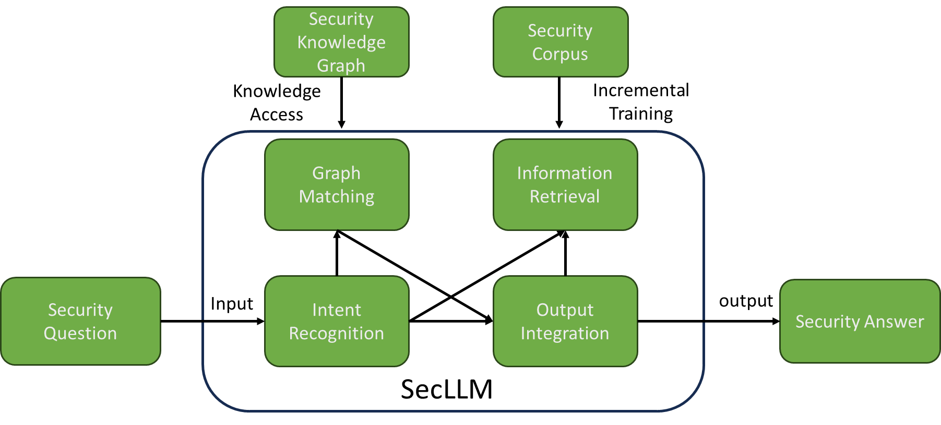
Use Case: security customer service Q&A
Requirement: Provide high-quality, high-efficiency, and intelligent security issue resolution and support for both security professionals and general users to help them better understand security issues and make informed security decisions.

Slide 9
Use Case: Multi-source information mining
"B country faces cyber attack"
"Shocking! Large-scale power outage hits C area, affecting 200,000 people"
"500,000 devices hijacked by ransomware"
"D country plans to hold a major conference"
"Never buy new products from a certain company"
"Hacker 1 posts multiple messages on social media accounts"
"Strong holiday atmosphere in a certain place"
"Photos reveal truth, underground romance of a celebrity exposed"
"New vulnerability discovered in common software used in the power industry"
"Activity on a website of a certain hacker organization"
Historical experience from multiple sources of data
Hacker 1 suspected to be a member of a certain hacker organization
Power outage incident in C area may be related to the new vulnerability
A country needs to increase protection measures recently
Mention of A country by a certain hacker organization multiple times
Data breach of A country's citizens
Similar incidents have occurred in other countries in history, leading to massive cyber attacks six months later
Large amount of A country citizen data information for sale on the dark web
Merge related intelligence;
Organize the information according to the rules.

Slide 10
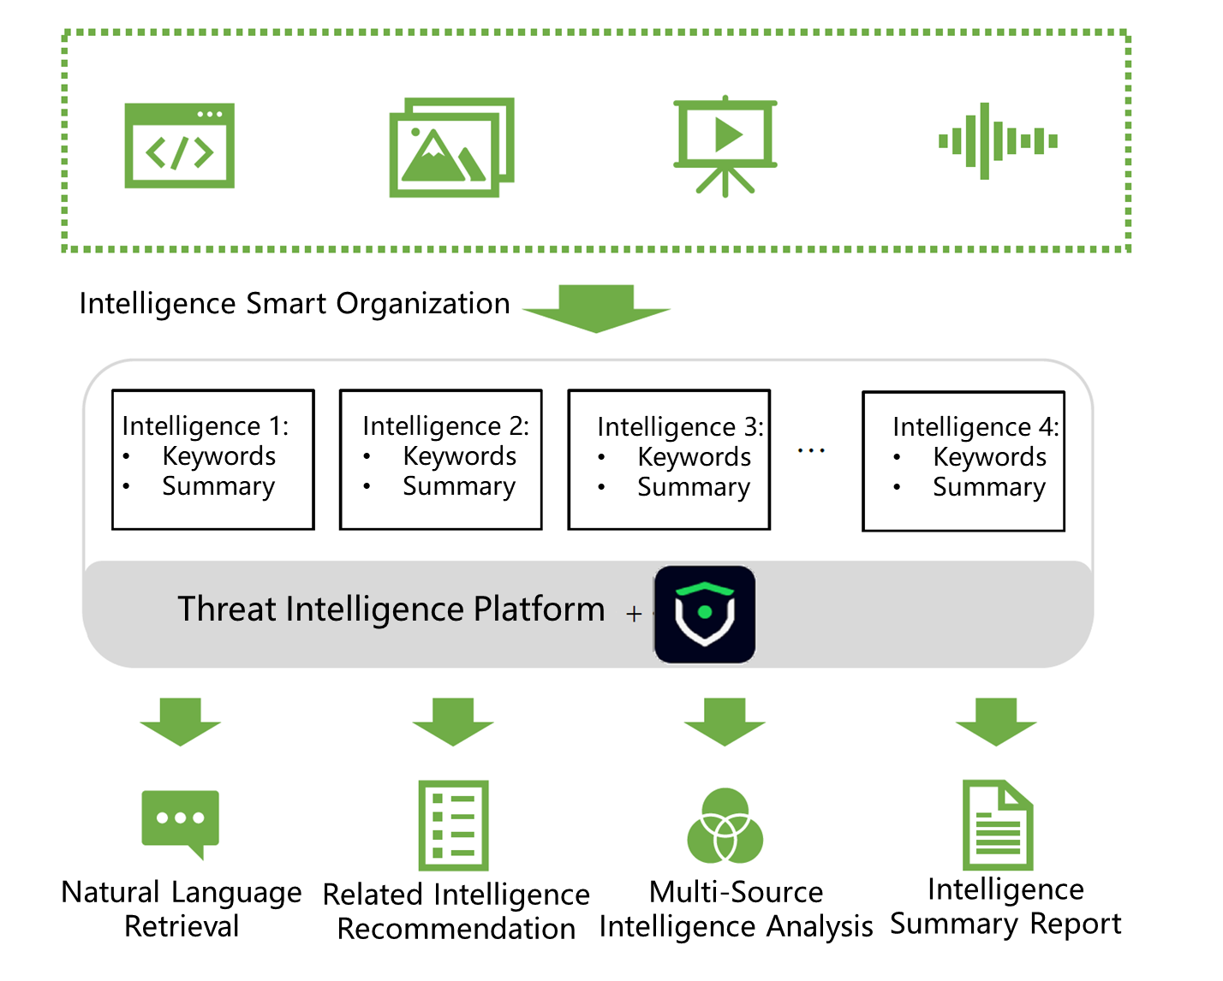
Use Case: Multi-source information mining
Requirement: Integrate a wide range of security information from the Internet to accurately analyze threats and help organizations address security challenges.
Solution：
1.Summarization: Refines and integrates information using security semantics, filtering noise and emphasizing essentials.
2.Analysis: Unifies diverse information through semantic and associative analyses, enhancing organizational efficiency.
3.Classification: Automatically categorizes intelligence by identifying connections and similarities, aiding integration.
4.Entity Evaluation: Assesses entity characteristics, relevance, and relationships for initial insights, including risk levels.

Slide 11
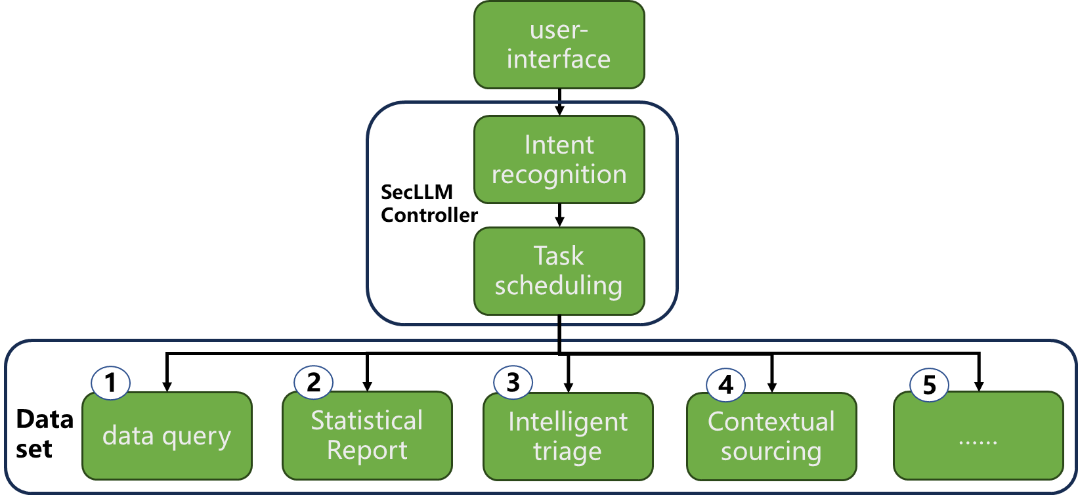
Use Case: Security Copilot
Requirement: Intelligent Operations Copilot boosts security efficiency through human-machine collaboration, enhancing threat detection and response for effective network security maintenance.
Solution：SecLLM triggers tools to execute decisions, adjusting in real-time based on feedback. In the operational framework, SecLLM acts as the decision center, interpreting user inputs and utilizing tools for expert judgment.

Slide 12
Summary
Large language models can accelerate the technological transformation in cybersecurity.
We have explored the applications of LLM in various aspects of cybersecurity, demonstrating its potential.
We welcome more discussions and exchanges on this topic!

Slide 13
Thanks!
Notes:
That’s all. Thank you!
Thanks for your comments, we consider SAV-D is SAV’s improvement and is covered by charter.
We will seriously think about this.
I hope we can have deep communication through mailing list later

